Slide 1
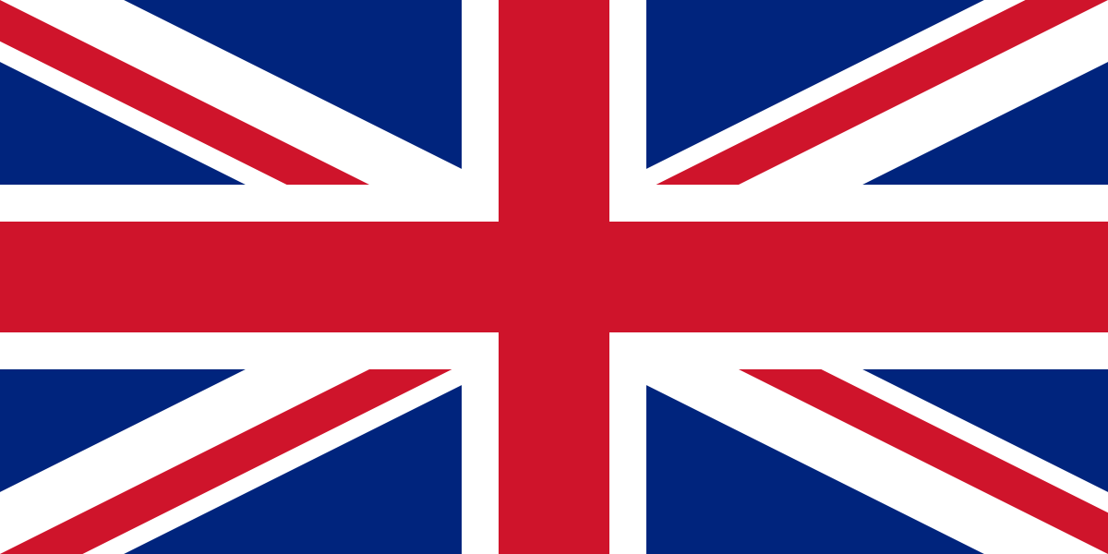
1763: The French and Indian War

Slide 2
Proclamation of 1763
The Proclamation of 1763, signed by King George III of England, prohibits any English settlement west of the Appalachian mountains and requires those already settled in those regions to return east in an attempt to ease tensions with Native Americans.

Slide 3
Proclamation of 1763
Why does this matter?

Slide 4
What happened?
The early colonial wars between France and Britain were fought primarily in Europe. American events played relatively minor roles.
After three rounds, no clear victor had emerged.
So they fought a fourth one.
Washington would later warn us against getting involved in European affairs.

Slide 5
French and Indian War
Following the third of these conflicts, King George’s War (1740-1748), French authorities in North America began to establish a string of forts in the Ohio country west of the Allegheny Mountains.
Their intent was to keep fur trapping and trading activities in the hands of French citizens and to deny the area to land-hungry American colonists.

Slide 6
French and Indian War
In the 1740s, a group of Virginians received from the Crown a massive grant of lands in the Ohio valley. The subsequent Ohio Company was established to invest in western lands and, secondarily, to engage in the fur trade.
Understandably, tensions between the contending powers mounted rapidly.

Slide 7
French and Indian War
The picture was further complicated by the area’s native allegiances.
As a rule, most of the tribes tended to favor the French who enjoyed a reputation for conducting business more fairly than the British.
Further, the French trappers and traders did not threaten to inundate the region with settlers, unlike the British colonists.
French would typically marry the natives and be adopted as members of the tribe.

Slide 8
French and Indian War
In 1753, George Washington and a small group of men were dispatched into the disputed territory by Virginia lieutenant governor Robert Dinwiddie.
He was a member of the Ohio Company, as were Washington and his brother Lawrence.
The intent was to deliver a letter of protest to French officials, who summarily refused the request to vacate.

Slide 9
French and Indian War
During this journey, Washington noted a strategically located site at the location of present-day Pittsburgh.
Acting on Washington’s intelligence report, British officials sent a small force to the area where they began to construct a fort.
Their labors were interrupted by a much larger French contingent, which chased off the British and completed the fortification, naming it Fort Duquesne.

Slide 10
French and Indian War
The Battle of Great Meadows
In 1754, Governor Dinwiddie attempted, but failed to secure assistance from other colonies to expel the French. He turned again to Washington, then 22 years old, who led his men westward into the disputed area.

Slide 11
French and Indian War
The Battle of Great Meadows
On May 28, Washington’s forces surprised a group of French and Indians, inflicted heavy casualties and took a number of captives.
The colonial forces then hastily constructed the aptly named Fort Necessity, in the Great Meadows not far from Fort Duquesne.

Slide 12
French and Indian War
The Battle of Great Meadows
On July 3, the French forces struck back.
After a day-long battle — the first of the French and Indian War — Washington signed terms of surrender and returned with his defeated men to Virginia.
The French commander treated his opponents leniently in the hope of avoiding a broader conflict.
Nevertheless, the opening shots of the French and Indian War had been fired.

Slide 13
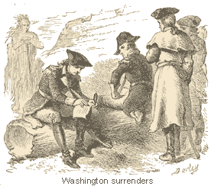
French and Indian War

Slide 14
French and Indian War
The conflict then proceeded through three phases:
The early period saw localized action in North America and began with Washington's loss at Fort Necessity. Neither side committed much in troop strength or resources. Most of the action was confined to attempts to capture the opponent's fortified positions on the frontier.
A middle phase began with a declaration of war between France and Britain, which touched off the first true world war (Seven Years’ War). The North American conflict might have remained a localized affair, but a realignment of European alliances ignited new rivalries to add to the simmering feud between Britain and France.
A final phase was highlighted by the British decision to concentrate on the North American theater of the conflict. Investment of huge sums of money and innovative new military talent helped to provide the margin of victory.

Slide 15
Pontiac’s Rebellion
Native anger was understandable and was rooted in several issues beyond their refusal to acknowledge defeat in the recent war:
English dominance in North America meant the construction of new forts and the movement of new settlers into traditional Indian lands. The earlier French presence had been slight and the relationship often harmonious.
British traders lacked the reputation for fairness in dealing with the Indians that had been the hallmark of the French. The natives had become dependent on European firearms, ammunition and other manufactured goods, and were now forced to deal with untrustworthy English partners.

Slide 16
Pontiac’s Rebellion
Native anger was understandable and was rooted in several issues beyond their refusal to acknowledge defeat in the recent war:
British arrogance was well-known among the Indians. The French in many instances had married native women and been adopted by the tribes.
Few British followed that example and many expressed utter contempt for the natives' customs and worth as human beings.
Tensions were further heightened when, in early 1763, Sir Jeffrey Amherst, the new North American governor-general, announced that he would discontinue the practice of presenting annual gifts to the tribes, an event long honored by the French.
The Indians were insulted by this snub, but also were angry to be denied the expected tools, blankets, guns and liquor.

Slide 17
Pontiac’s Rebellion
The resulting widespread unhappiness presented a platform for a native visionary, who was known simply as the Delaware Prophet.
He preached ardently for a return to traditional ways and for the rejection of contact with the British.
This platform was soon adopted by the then undistinguished Ottawa chieftain, Pontiac (c.1720-1769), who was known primarily for his oratorical skills and as a supporter of the French in the recent war.
His message found sympathetic ears among the Delaware, Seneca, Chippewa, Miami, Potawotomi and Huron, among others.

Slide 18
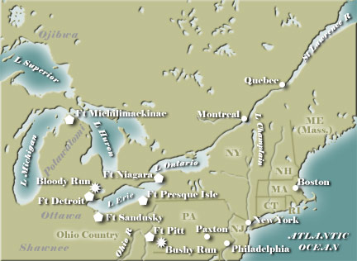
Pontiac’s Rebellion

Slide 19
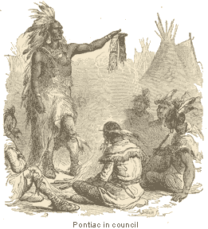
Pontiac’s Rebellion
After 1764, Pontiac's influence among the tribes waned rapidly.
He made recruiting trips into the South and West, but found few interested parties.
In 1766, Johnson managed to conclude a general peace treaty in which Pontiac received a pardon.
He lived quietly for several more years before being killed by a fellow Indian.

Slide 20
Result of the War and Pontiac?
One of the prime results of Pontiac's Rebellion was the decision of British policymakers to issue the Proclamation of 1763, a measure designed to shut down white settlement of the West until organizational reforms could be effected.
Did the colonists like this?

Slide 21
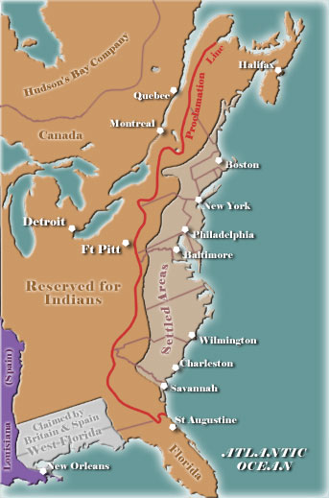
Proclamation Line

Slide 22
Two motivations for this policy
To avoid warfare with the Indians. This aim had little to do with affection for the tribes, but simply reflected the facts that Indian conflicts were very expensive and that the British had not yet deployed sufficient soldiers in the west to keep the peace.
Some Indians welcomed this policy, believing that the separation of the races would allow them to resume their traditional lifeways; others realized that the proclamation, at best, would only provide some breathing room before the next onslaught of settlers.

Slide 23
Two motivations for this policy
To concentrate colonial settlements on the seaboard where they could be active parts of the British mercantile system.
The first priority of British trade officials was to populate the recently secured areas of Canada and Florida (see Treaty of Paris), where colonists could reasonably be expected to trade with the mother country; settlers living west of the Appalachians would be highly self-sufficient and have little opportunity to trade with English merchants.

Slide 24
Final Note
It is also important to note that most of the fighting against the Indians during this uprising was conducted by British regulars.
The colonial soldiers had performed poorly during the French and Indian War (with a number of exceptions, including Rogers Rangers) and were purposely excluded by British commanders.

