Slide 1
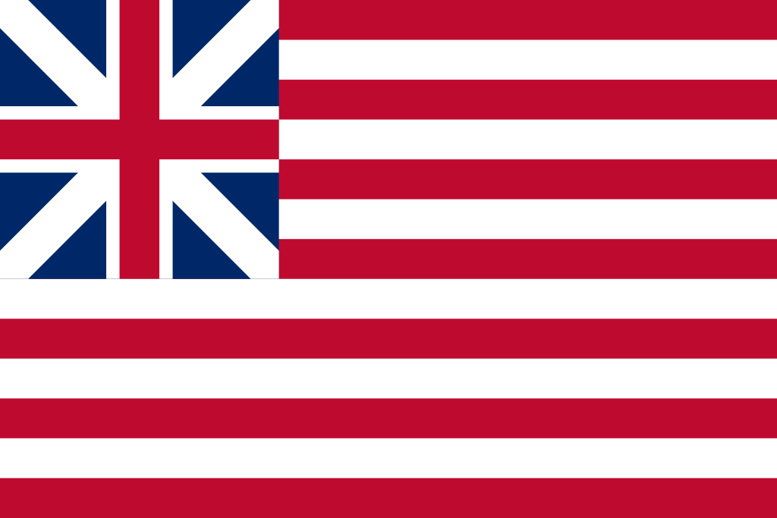
The Flag of the Grand Union
“If this be treason, let us make the most of it!”

Slide 2
Can you place these in order? Do you know what they did?
Sons of Liberty
Molasses Act (Sugar and Molasses Act of)
Declaratory Act
The Sugar Act
WAR! Hoo, Yeah, What is it good for?
The Stamp Act
Townshend Revenue Acts
Proclamation of 17??
Boston Massacre
The Tea Act
Coercive Acts (Intolerable Acts)
The Quartering Act
Boston Tea Party
The Currency Act
First Continental Congress

Slide 3
Timeline - Answers
Molasses Act (Sugar and Molasses Act of 1733)
Proclamation of 1763
The Sugar Act 1764
The Currency Act 1764
The Stamp Act 1765
The Quartering Act 1765
Sons of Liberty 1765
Declaratory Act 1766
Townshend Revenue Acts 1767
Boston Massacre 1770
The Tea Act 1773
Boston Tea Party Dec. 16, 1773
Coercive Acts (Intolerable Acts) 1774
First Continental Congress
WAR! Hoo, Yeah, What is it good for?

Slide 4
Remember from last time?
Next Time:
Coercive Acts
Disarming of Americans
Continental Congress
A certain declaration of something…
Okay?
Let’s go!

Slide 5
Coercive Acts
The Intolerable Acts was the American Patriots' name for a series of punitive laws passed by the British Parliament in 1774 after the Boston Tea party.
They were meant to punish the Massachusetts colonists for their defiance in throwing a large tea shipment into Boston harbor.
In Great Britain, these laws were referred to as the Coercive Acts.

Slide 6
Coercive Acts - Overview
British Parliament hoped these punitive measures would, by making an example of Massachusetts, reverse the trend of colonial resistance to parliamentary authority that had begun with the 1765 Stamp Act.
A fifth act, the Quebec Act, enlarged the boundaries of what was then the Province of Quebec and instituted reforms generally favorable to the French Catholic inhabitants of the region; although unrelated to the other four Acts, it was passed in the same legislative session and seen by the colonists as one of the Intolerable Acts.

Slide 7
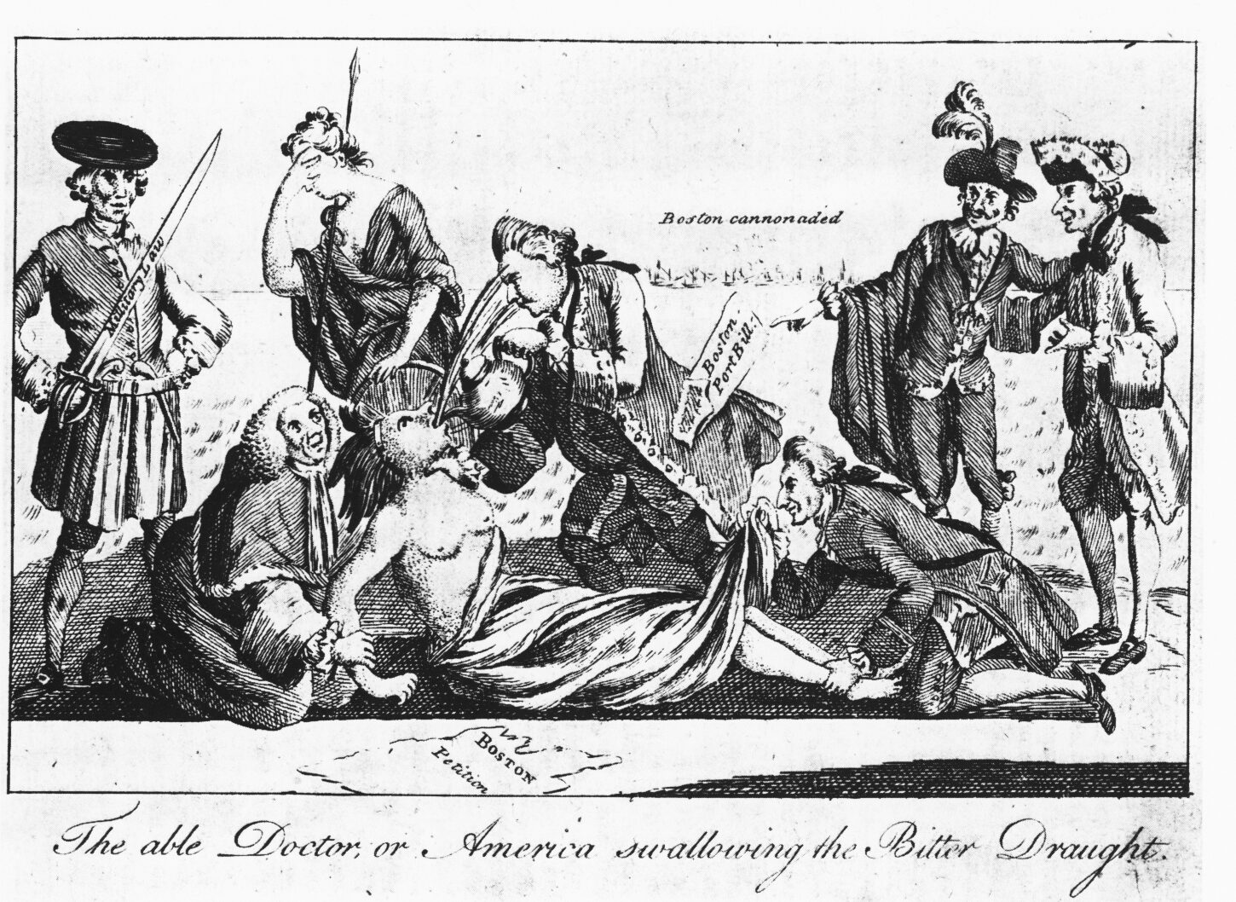
Coercive Acts
This Patriot cartoon depicting the Coercive Acts as the forcing of tea on an American woman (a symbol of the American colonies) was copied and distributed in the Thirteen Colonies.

Slide 8
Coercive Acts - Overview
The acts took away Massachusetts self-government and historic rights, triggering outrage and resistance in the Thirteen Colonies.
Or more to the point, they were “the last straw.”

Slide 9
Coercive Acts - Details
Boston Port Act (June 1, 1774)
Administration of Justice Act (May 20, 1774)
Massachusetts Government Act (May 20, 1774)
Quartering Act (June 2, 1774)

Slide 10
Coercive Acts - Details
Boston Port Act (June 1, 1774)
Boston harbour was closed to all shipping except for coasters carrying necessary fuel and supplies, until:
the East India Company had been compensated for its losses
the injured customs officers had been compensated for their injuries
George III deemed that peace was sufficiently restored that trade could be resumed
The customs service was moved to Salem and Marblehead.

Slide 11
Coercive Acts - Details
Massachusetts Government Act (May 20, 1774)
the elected Assembly was to be replaced by a mandamus council nominated by the Governor (General Gage), to sit at Salem
the Governor was given the power to appoint/dismiss all law officers
there were to be no Town Meetings without royal assent
there was to be no election of juries by the freeholders

Slide 12
mandamus
Anyone care to guess?

Slide 13
mandamus
Anyone care to guess?
"I command".
This term was used in the American colonies when the king made appointments without the consent of the people.
Literally, 'mandamus' means "we command" but the word is used legally for a "Crown writ" and the monarch uses the "Royal 'we' ".
Logically it translates as "I command".

Slide 14
Coercive Acts - Details
Administration of Justice Act (May 20, 1774)
This empowered the Governor of Massachusetts to remove trials to another colony or to Britain if he felt that the juries in Massachusetts would be partial.
The Act applied largely to Crown officials and troops carrying out their orders.
The Rebels called this the "Murder Act".

Slide 15
Coercive Acts - Details
Quartering Act (June 2, 1774)
This was an amendment to the 1765 Quartering and Mutiny Act which broadened the law.
The Act allowed for the quartering of these men in empty houses, inns and barns but also in private houses if necessary.
Under the 1765 Act, the colonists were required to provide accommodation for British troops.
The soldiers were also to be supplied with fire, candles, vinegar, salt, bedding, cooking utensils, up to five pints of small beer or cider or half a pint of rum mixed with two pints of water per man.
The colonists were to meet the expense of this for themselves.

Slide 16
The American Response?
WE STILL DON’T ATTACK!
But they try and take our guns!!!
Formation of the Continental Congress.

Slide 17
The Gun Debacle
The particular provisions of the Coercive Acts were offensive to Americans, but it was the possibility that the British might deploy the army to enforce them that primed many colonists for armed resistance.

Slide 18
Debacle
1. A sudden, disastrous collapse, downfall, or defeat; a rout. 2. A total, often ludicrous failure. 3. The breaking up of ice in a river. 4. A violent flood.

Slide 19
The Gun Debacle
The Patriots of Lancaster County, Pennsylvania, resolved: “That in the event of Great Britain attempting to force unjust laws upon us by the strength of arms, our cause we leave to heaven and our rifles.”
A South Carolina newspaper essay, reprinted in Virginia, urged that any law that had to be enforced by the military was necessarily illegitimate.

Slide 20
The Gun Debacle
The Royal Governor of Massachusetts, General Thomas Gage, had forbidden town meetings from taking place more than once a year.
When he dispatched the Redcoats to break up an illegal town meeting in Salem, 3000 armed Americans appeared in response, and the British retreated.
Gage’s aide John Andrews explained that everyone in the area aged 16 years or older owned a gun and plenty of gunpowder.

Slide 21
The Gun Debacle
Military rule would be difficult to impose on an armed populace.
Gage had only 2,000 troops in Boston.
There were thousands of armed men in Boston alone, and more in the surrounding area.
One response to the problem was to deprive the Americans of gunpowder.
I won’t mention the recent run on ammo in America…

Slide 22
The Gun Debacle
You can guess what happened.

Slide 23
Continental Congress
The First Continental Congress was a meeting of delegates from twelve of the thirteen colonies that met on September 5 to October 26, 1774 at Carpenters' Hall in Philadelphia, Pennsylvania

Slide 24
Continental Congress
The Congress was attended by 356 delegates appointed by the legislatures of the thirteen colonies which were hoping for British assistance with Native American problems on its frontier.
The Congress met briefly to consider options, including an economic boycott of British trade; rights and grievances; and petitioned King George III for redress of those grievances.
The Congress also called for another Continental Congress in the event that their petition was unsuccessful in halting enforcement of the Intolerable Acts.

Slide 25
Continental Congress
VIDEO TIME!

Slide 26
Continental Congress - Result
The Continental Congress created the Continental Association, an agreement to boycott British goods and, if that did not get the Coercive Acts reversed after a year, to stop exporting goods to Great Britain as well.
The Congress also pledged to support Massachusetts in case of attack, which meant that all of the colonies would become involved when the American Revolutionary War began at Lexington and Concord.

