Slide 1
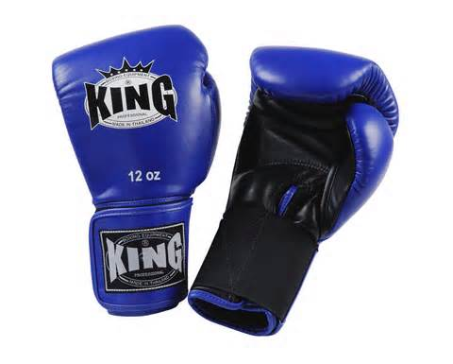
Team Debates

Slide 2
FORMAT
Speech:
1AC Time: 8 min.
1NC Time: 8 min.
2AC Time: 8 min.
2NC Time: 8 min.
1NR Time: 4 min.
1AR Time: 4 min.
2NR Time: 4 min.
2AR Time: 4 min.

Slide 3
TEAM MEMBERS
In general, the members of each team alternate giving speeches, so that the same person gives both the 1AC and the 1AR, the same person gives the 2NC and the 2NR, etc. Occasionally, the rules will allow a change in this format. For example, affirmative teams will sometimes go "inside-outside" so that one person (usually the weaker member) gives the 1AC and the 2AR, while the other (stronger) debater gives the 2AC and the 1AR.

Slide 4
TEAM MEMBERS
With our three person team you will have the option of divvying up the work as you see fit.
e.g.
2 argue, 1 rebuts (I recommend this one!)
2 argue and do rebuttal, the third writes down notes and organizes rebuttals for others

Slide 5
YOU WILL NOT SEE
1. A tautology. A tautological case is one that is immediately and logically true by construction. For example, "Bill Clinton is the best Democratic president in the last 20 years o the 20th century." would be a tautology, since Bill is the only Democrat to have attained the presidency in the specified time period.
“You’re my favorite dad.” could be another.

Slide 6
YOU WILL NOT SEE
2. A truism. A truistic case is one that no moral person could possibly disagree with. For example, “Bears should not be skinned alive for entertainment purposes" would be a truism.
Of course, the definition of truistic is contentious, because it is almost always possible to find someone who disagrees with a proposition, and what is considered moral can be culture-specific.

Slide 7
YOU WILL NOT SEE
3. A specific-knowledge case. A specific-knowledge case is one that would require the sides to know more about a topic than it could reasonably be expected to know. In general, debaters are expected to be familiar with current events and popular culture.
An example of a specific-knowledge case would be, "The U.S. Air Force should discontinue use of the V26 Osprey helicopter because of its low flight-to-thrust ratio." Another would be, "My partner should dump his girlfriend." Unless the evils and advantages of his girlfriend were well known, it would be unreasonable to expect the negative to refute the case.

Slide 8
QUESTIONS
???

