Slide 1
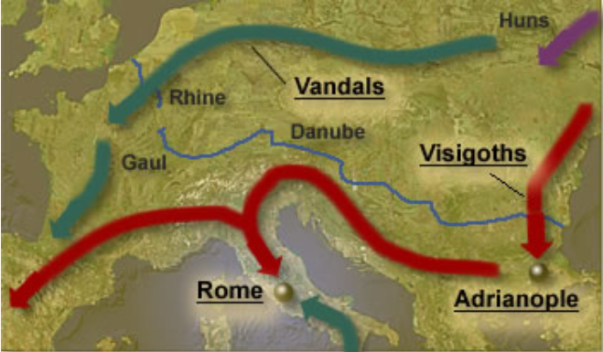
Decline and Fall of Rome OR All Good Things Must Come to and End
Daily Life in Ancient Rome w/ Mr. C

Slide 2
The Grandeur that was Rome
At its height, the boundaries of the Roman Empire stretched from the north of England across the North Sea, along the Rhine and Danube Rivers to the Caspian Sea, south to Egypt, along the coast of Africa to Spain.
The decline and eventual collapse of this vast empire took place over a period of years before reaching its bitter end in the middle of the 5th century.
Its demise followed a pattern in which extended periods of weakness were followed by unsustainable bursts of strength that inevitably led to further decline.
The forces that allowed its destruction came from the internal decay of its economic, political and military structure combined with relentless barbarian attacks.

Slide 3
The Grandeur that was Rome
There is no one single reason, but a series of problems that grew too large to solve.
The empire grew too large to govern.
The Romans tried to solve this by dividing the empire.
The Romans no longer wanted to serve in the army.
The Romans tried to solve this by hiring barbarians to fight for them.
Civil wars broke out in Rome between different factions.
The rich grew disinterested in helping Rome and only wanted more for themselves and their families.
The population of Rome shrank.
Trade decreased while taxes and prices increased.
The poor were overtaxed.
The use of slaves put people out of work.

Slide 4
Rome, at its climax!

Slide 5
So What Happened? - Economics
Continuous occurrences of diseases such as Malaria and other plagues caused a decline in the Roman Empire population.
During certain regimes, their currency was debased. Their coins basically didn’t have the actual value; instead, the worth of the currency depended on the amount of silver it contained. Their coins were made up of no more than 1% silver and, as a result, severe inflation followed.
Before 1965, quarters contained 90% silver, 10% copper.
After 1965, two layers of cupronickel, 75% copper and 25% nickel, on a core of pure copper.
They are called a "Johnson Sandwich" after Lyndon B. Johnson, the U.S. President at the time.
Rome depended on its empire for resources originating from mining and farming practices. Rome turned out to be very poor and had trouble managing the economy.
High taxation caused distress among many classes in Ancient Rome.

Slide 6
So What Happened? - Politics

Slide 7
So What Happened? - Politics
Corruptions in senate and instability in the politics came into existence. Officials accepted bribes in exchange for favors. Furthermore, consuls and officials would offer positions in office to those who could pay of a huge amount of money.
Nero – Persecution, Lavish Spending
Caligula – Made his horse a senator
Emperor Constantine divided the Roman Empire into two halves and declared Constantinople as the new capital of Roman society. The western half of the Roman Empire lost its power over towns in the East. The loss of power over the eastern half caused a huge decline in profits from the treasury thus weakening the military in terms of warfare.

Slide 8
So What Happened? - Military
Rome no longer had a control over military situations because the Roman army was comprised of trained barbarian soldiers. The barbarian soldiers of the Roman army were much less effective compared to the superior infantry that the Roman Empire had in previous centuries.
Many of the Roman citizens who were expected to serve the Roman military refused to sign. The new forces of the Roman military were low on morale and were very lethargic. They remained careless about the development of Rome.
Many of the men from the Roman army who served the country had retired and did not want to be bothered with government affairs.
Many locations were remote and the governing of Romans was lenient. Instead of keeping their original heritage, many of the soldiers from these locations were married to locals and adopted to local customs, values, attitudes, and beliefs.
Hadrian soon realized that Rome was no longer in a position to continue expansion. Hadrian took a defensive stance and ordered the construction of a defensive which marked the northern limit of Roman Empire. It was impossible for his troops to defend such a wide area due to continuous waves of barbarians directed to break the walls.

Slide 9
"Who could believe this?"
St. Jerome was born around the year 340. He came to Rome and was baptized there around 360. He devoted the rest of his life to scholarly pursuits and the translation of the Bible into Latin. He died in 420. He wrote the following observations describing the devastation of the Empire around 406:
Nations innumerable and most savage have invaded all Gaul. The whole region between the Alps and the Pyrenees, the ocean and the Rhine, has been devastated by the Quadi, the Vandals, the Sarmati, the Alani, the Gepidae, the hostile Heruli, the Saxons, the Burgundians, the Alemanni, and the Pahnonians.

Slide 10
So What Happened? - BARBARIANS
In 376, the Visigoths crossed the Danube River - a traditional boundary of the Roman Empire - and swarmed southward. Two years later, the Visigoths defeated the Romans at the battle of Adrianople, further weakening the Empire.
Vandals crossed the Rhine River - another traditional boundary of the Empire- in 406. They continued their assault southward to Spain, crossing the Pyrenees Mountains in 409. A year later, the Visigoths sacked Rome and continued on to Spain.

Slide 11
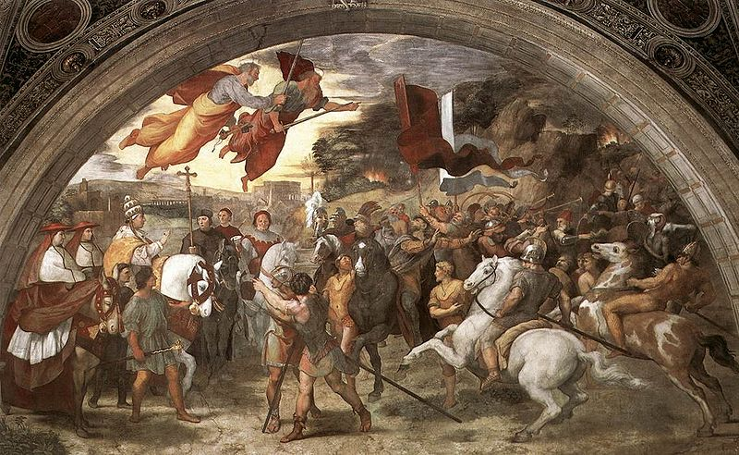
So What Happened? - BARBARIANS
In 452 Atilla the Hun invaded Rome and planned to sack the city. Pope Leo I persuaded him to turn back from his invasion of Italy.
Raphael's The Meeting between Leo the Great and Attila depicts Leo, escorted by Saint Peter and Saint Paul, meeting with the Hun king outside Rome

Slide 13
So What Happened? - BARBARIANS
In 429, the Vandals crossed the Strait of Gibraltar and reached the shores of Africa. They continued their assault eastward along the coast and re-crossed the Mediterranean to make a landing in Italy. In 455 they followed in the footsteps of the Visigoths and sacked Rome. The Western Roman Empire was dead.

Slide 14
So What Happened? - BARBARIANS
In the West, the office of emperor soon degenerated into being little more than a puppet of a succession of Germanic tribal kings, until finally the Heruli Odoacer simply overthrew the child-emperor Romulus Augustulus in 476, shipped the imperial regalia to the Emperor Zeno in Constantinople and became King of Italy.
Though during his own lifetime Odoacer maintained the legal fiction that he was actually ruling Italy as the viceroy of Zeno, historians mark 476 as the traditional date of the fall of the Roman Empire in the West.

Slide 15
The End of Rome?
After 293 the empire was split into East and West.
The fall of Romulus Augustus in 476 marks the fall of the Roman Empire in the West.
The Roman Empire in the East would continue on for another thousand years!
REE/Byzantine Empire, with its capital at Constantinople, lasted until the city was sacked by the Muslims in 1453.
“Rums”
Istanbul
Caesar -> Kaiser ->Tsar

Slide 16
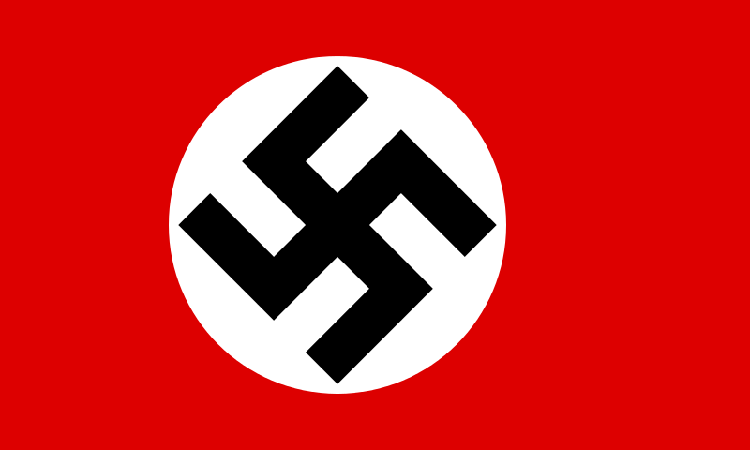
Or is it? Everybody wants to be Roman!
Hitler’s Third Reich
1st – Holy Roman Empire (962-1806)
2nd – German Empire (1871-1918)
3rd – Nazi Germany

Slide 17
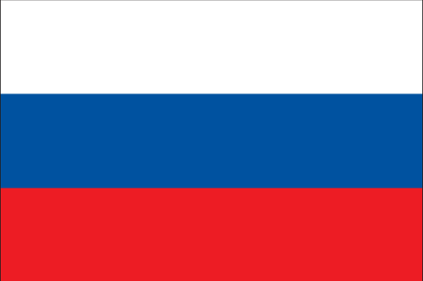
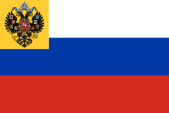
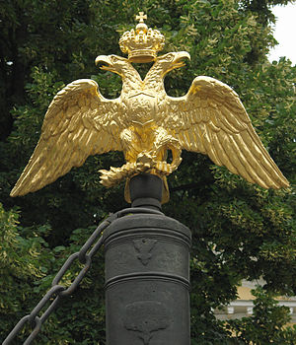
Or is it? Everybody wants to be Roman!
Ivan III's second marriage to Zoe Palaiologina (a niece of the last Byzantine emperor Constantine XI)

