Slide 1
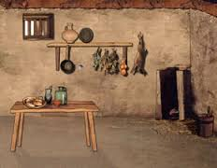
Home Sweet Home OR Dude, I Live in THAT?!?!
Daily Life in Ancient Rome w/ Mr. C

Slide 2
The Earliest Homes
The earliest Romans living on the Palatine hill were essentially farmers and shepherds, wearing animal skins as clothing and building their abodes of whatever construction materials were readily available. Archeological digs on the hills of Rome have brought to light a number of clues as to what these huts were like and when they were built.
Roman mythology and tradition places the founding of Rome around the 8th century BC but in fact archeological finds suggest early settlements as early as the 10th century BC.
These early huts were generally rectangular or lozenge shaped. They were made by planting large trunks into the ground, say three per side. The walls would be made by filling the space between them with smaller sized wood and straw/mud.
The roof cover would have been held by wooden beams meeting in the centre at the vertex (ie a traditional roof shape) and supported by one or more trunks standing in the centre of the hut. Roof covering was probably of straw. A hole in the roof allowed smoke from the internal fire to escape.

Slide 3
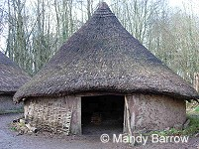
The Earliest Homes

Slide 4
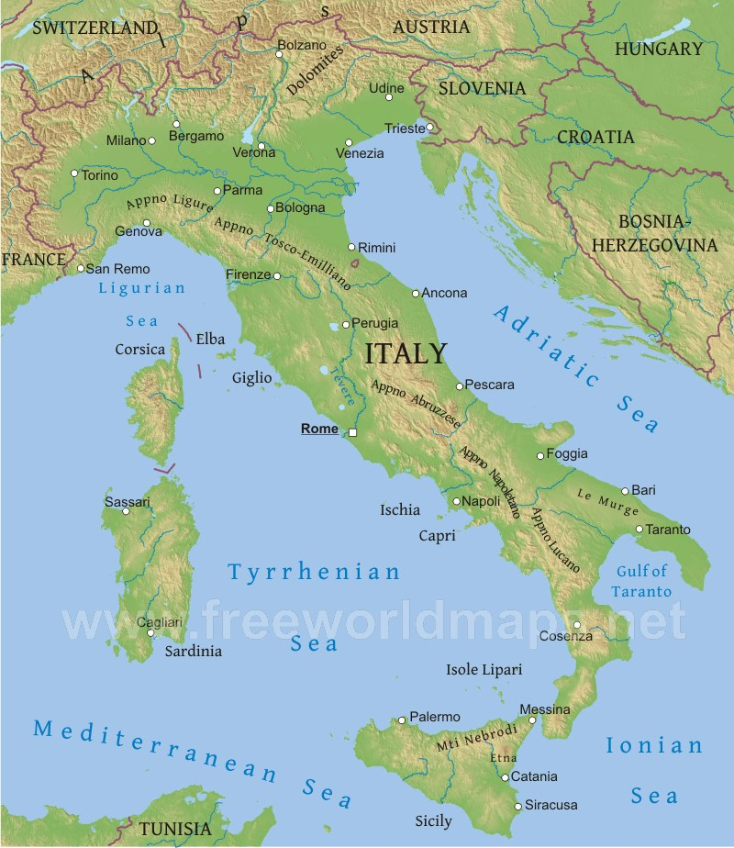

Slide 5
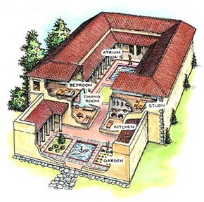
Early Roman House
Looking at the back…

Slide 6
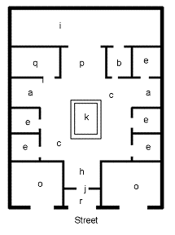
Early Roman House
A – Ala / ???
C – Atrium / ater=black
E – Cubiculum / A bedroom.
I – Hortus / _______(Horticulture)
K – Impluvium / cistern
P – Tablinum / den (Men only!)
Q – Triclinium / _______

Slide 7
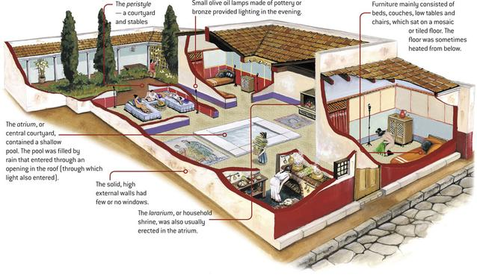
Early Roman House

Slide 8
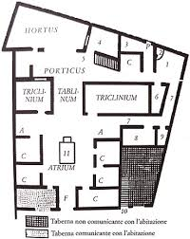
Early Roman House – IN REALITY

Slide 9
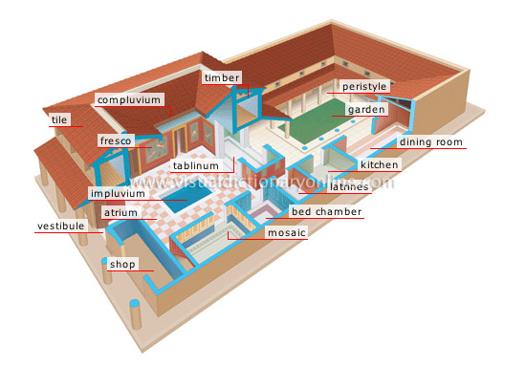
Late Roman Villas
This ain’t your daddy’s hut!
We’ve moved out to the posh areas/country.

Slide 10
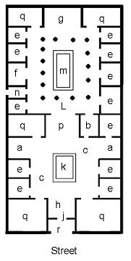
Late Roman Houses
What’s new here?
F - Culina / _________ (Nom nom)
L - Peristylium / A range of columns
M - Piscina / Pool or fountain

Slide 11
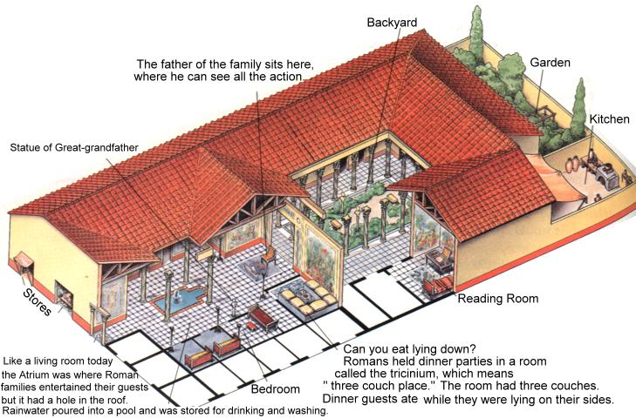
Late Roman House / Villa

Slide 12
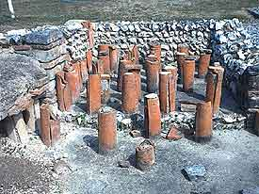
The Hypocaust
Instead of a fire in each room, they had a special fire room built against an outside wall. The floors were raised on pillars and the walls of the villa were hollow. The heated air from the fire went to all the other rooms, through these spaces under the floor and in the walls.
It was a very clever invention and after the Romans left, it was centuries before the British people had central heating again.
This is a picture of the hypocaust at Rockborne in Hampshire. These pillars (red) held up the floor and allowed the hot air to circulate underneath, heating the room.

Slide 13
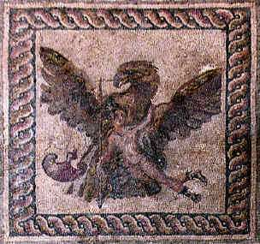
The Mosaics
Wealthy Romans might decorate their house with mosaics, floors made of tiny, colored clay pieces that together made a wonderful picture. They were called tesserae.
A wealthy Roman might have chosen a design from a pattern book, much like choosing wall paper today! Also it is thought that many of the designs might have arrived pre-made, so all the workman had to do was to stick them to the floor!
The mosaic here shows a man and a giant eagle. It is made from thousands of tiny tile pieces. They took a very long time to make.

Slide 14
Roman Apartments
Roman town planners are also famous for having invented the first apartment blocks, called "insula" or "insulae".
Some examples of these apartment buildings can still be seen in cities such as Rome or Ostia (Rome's harbor).
Interestingly they are not to be found at Pompeii where the highest building had something like three floors and the norm was just a single floor.
In spite of its wealth Pompeii had not outgrown its limits as attested by the many large gardens and relatively undeveloped areas to the east of the city, ie availability of space and population density was clearly a strong factor in whether or not apartment blocks were built up.
Roman apartment buildings could be as high as 5 or 6 floors and measure some 30 feet in length and 60 feet in height.
The insulae in the poorest areas could be built out of extremely bad materials such as clay, straw, wood and crude bricks and often owed their structural strength to the support of neighboring buildings, not a healthy situation.
This accommodation, with very little by the way of hygiene was generally regarded as a temporary stepping stone towards something of higher quality.
But the sad fact is that for many, this was NOT temporary.

