Slide 1
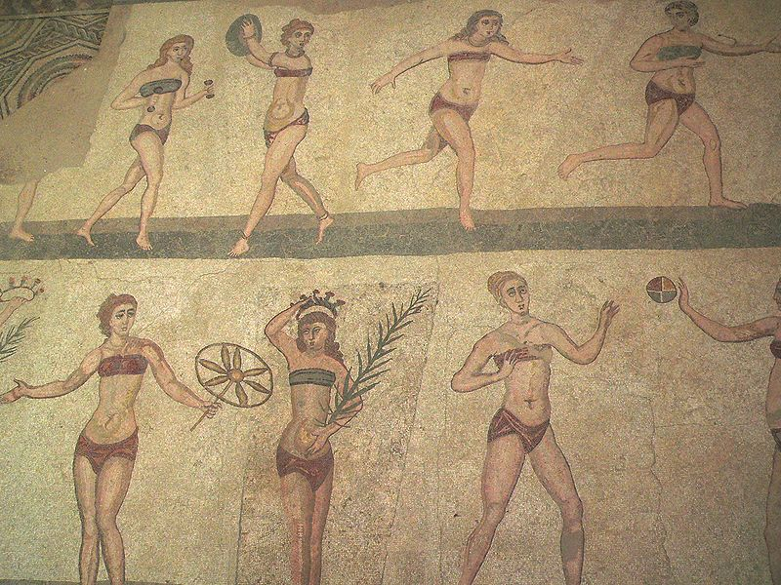
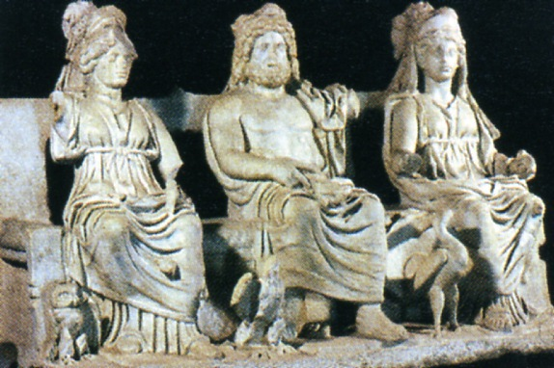
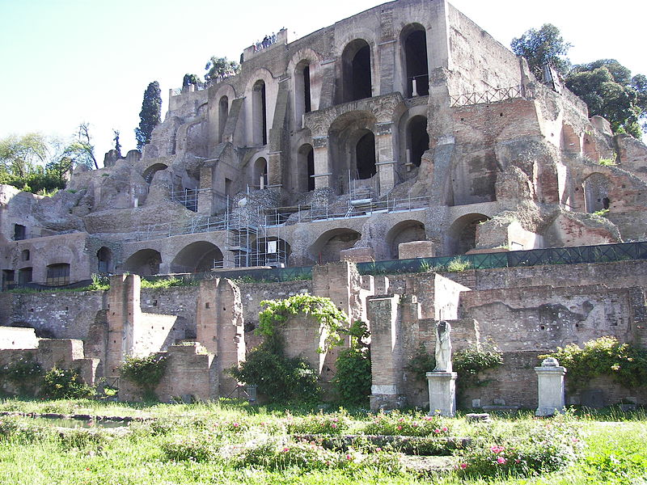
Roman Ladies: Thank Heaven for Little Girls!
Daily Life in Ancient Rome w/ Mr. C

Slide 3
Next Time
Food
Bathrooms
Religion (3/12)
Women & Marriage (3/26)
MIDTERM (EXAM 1 )/ War (4/2)
Spring Break!!!
Home Life (4/16)
City Life (4/23)
FINAL EXAM / Y mucho, mucho mas! (4/30)

Slide 4
Overview
The one major public role reserved solely for women was in the sphere of religion: the priestly office of the Vestals. Freed of any obligation to marry or have children, the Vestals devoted themselves to the study and correct observance of rituals which were deemed necessary for the security and survival of Rome but which could not be performed by the male colleges of priests.

Slide 5
To be a girl…
Freeborn women in ancient Rome were citizens (cives), but could not vote or hold political office.
Inscriptions and especially epitaphs document the names of a wide range of women throughout the Roman Empire, but often tell little else about them.
Some vivid snapshots of daily life are preserved in Latin literary genres such as comedy, satire, and poetry, particularly the poems of Catullus and Ovid, which offer glimpses of women in Roman dining rooms and boudoirs, at sporting and theatrical events, shopping, putting on makeup, practicing magic, worrying about pregnancy — all, however, through male eyes.
The Venerable Bede!

Slide 6
Always a Daughter
Both daughters and sons were subject to patria potestas, the power wielded by their father as head of household (familia). A Roman household was considered a collective (corpus, a "body") over which the pater familias had mastery (dominium).
Even apart from legal status, daughters seem no less esteemed within the Roman family than sons, though sons were expected to ensure family standing by following their fathers into public life.
A daughter was expected to be deferential toward her father and to remain loyal to him, even if it meant having to differ with her husbands.
A daughter kept her own family name (nomen) for life, not assuming that of her husband.

Slide 7
What’s in a Name? / The Name Game
Women in the early to mid-Republic were usually known by their family name (nomen).
A woman from the gens Aemilia would be called Aemilia; from the gens Cornelia, Cornelia; from the gens Sempronia, Sempronia; and so on.
If there were many daughters, a cognomen such as Tertia (Third) could indicate birth order, for example, Aemilia Tertia, the wife of Scipio Africanus.
The comparative adjectives Maior and Minor, meaning "the Elder" and "the Younger" when attached to a name, might distinguish between two sisters; for example, the daughters of Gaius Laelius Sapiens are known as Laelia Maior and Laelia Minor.

Slide 8
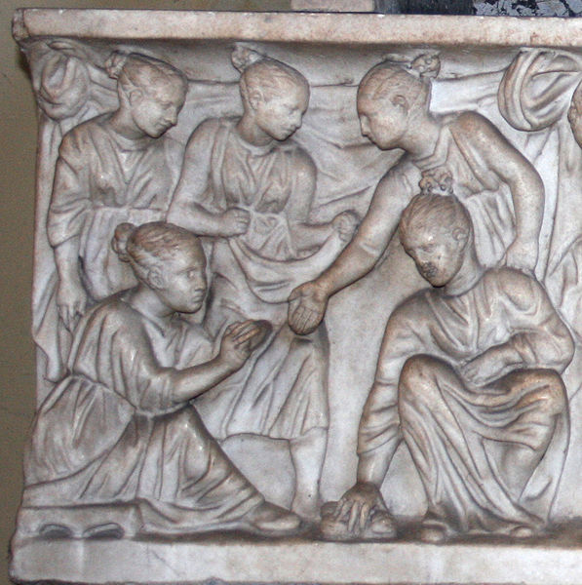
Childhood and Education I
Roman children played a number of games, and their toys are known from archaeology and literary sources. Girls are depicted in Roman art as playing many of the same games as boys, such as ball, hoop-rolling, and knucklebones. Dolls are sometimes found in the tombs of those who died before adulthood.
Girls coming of age dedicated their
dolls to Diana, the goddess most
concerned with girlhood, or to
Venus when they were preparing
for marriage.

Slide 9
Childhood and Education II
Some and perhaps many girls went to a public primary school. Ovid and Martial imply that boys and girls were educated either together or similarly, and Livy takes it for granted that the daughter of a centurion would be in school.
Children of the elite were taught Greek as well as Latin from an early age.
Children of both genders learned to behave socially by attending dinner parties and other events.
Girls as well as boys participated in religious festivals.
As they got older, their paths diverged (split).

Slide 10
Women & the Law
Although the rights and status of women in the earliest period of Roman history were more restricted than in the late Republic and Empire, as early as the 5th century BC, Roman women could own land, write their own wills, and appear in court as their own advocates.
An emancipated woman legally became sui iuris, or her own person, and could own property and dispose of it as she saw fit.
If a pater familias died, the law required the equal division of his estate amongst his children, regardless of their age and sex.
A will that did otherwise, or emancipated any family member without due process of law, could be challenged.
From the late Republic onward, a woman who inherited a share equal with her brothers would have been independent.

Slide 11
Marriage Law I
The pater familias had the right and duty to find a husband for his daughter, and first marriages were normally arranged.
Technically, the couple had to be old enough to consent, but the age of consent was 12 for girls and 14 for boys.
A daughter could legitimately refuse a match made by her parents only by showing that the proposed husband was of bad character.
In the early Republic, the bride became subject to her husband's potestas, but to a lesser degree than their children.

Slide 12
Marriage Law II
By the early Empire a daughter's legal relationship to her father remained unchanged when she married, even though she moved into her husband's home.
This arrangement was one of the factors in the degree of independence Roman women enjoyed relative to those of many other ancient cultures and up to the early modern period: although she had to answer to her father legally, she didn't conduct her daily life under his direct scrutiny, and her husband had no legal power over her.

Slide 13
Purpose of Marriage
Roman marriage wasn't a love match.
The purpose of marriage was to carry on the family line so the spirits of the dead could be honored.
Roman women were not only valued for the number of children that they produced, but also for their part in raising and educating children to become good citizens.

Slide 14
Marwiage is wat bwings us togever today.
During the classical era of Roman law, marriage required no ceremony, but only a mutual will and agreement to live together in harmony.
Marriage ceremonies, contracts, and other formalities were meant only to prove that a couple had, in fact, married.
Under early or archaic Roman law, marriages were of three kinds: confarreatio, symbolized by the sharing of bread (panis farreus); coemptio, "by purchase"; and usus, by mutual cohabitation.
Patricians always married by confarreatio, while plebeians married by the latter two kinds.

Slide 15
Marriage Customs I
The nuptiae was often begun with a celebration, combining legal, religious, and social features.
The typical upperclass wedding in the classical period tended to be a lavish affair. The expense of the wedding was normally the bride's family's responsibility. The day was carefully chosen, with various religious reasons as to why certain days should be avoided.
During engagement ceremonies, which typically took place before the wedding ceremonies, the groom would often hand his future wife an iron ring.
During wedding ceremonies the bride and groom often sacrificed an animal and asked the gods for a blessing.

Slide 16
Marriage Customs II
On the wedding day, the bride went with a procession to her new home, while the bridegroom went ahead of the bride to receive her.
With her, the bride brought a torch lit from her family's hearth, and was offered another torch and water, symbolizing the aquae et ignis communicatio.
She was then carried over the threshold by her attendants, not her husband. The words "Ubi tu Gaius, ego Gaia" may have been exchanged at this point.

Slide 17
Who’s Raising the Kids?
Roman wives were expected to bear children, but the women of the aristocracy, accustomed to a degree of independence, showed a growing disinclination to devote themselves to traditional motherhood. By the 1st century AD, most elite women avoided breast-feeding their infants themselves, and hired wet-nurses.
Since a mother's milk was considered best for the baby, aristocratic women might still choose to breast-feed, unless physical reasons prevented it.
The extent to which Roman women might expect their husbands to participate in the rearing of very young children seems to vary and is hard to determine. Family-values traditionalists such as Cato appear to have taken an interest: Cato liked to be present when his wife bathed and swaddled their child.

Slide 18
The Lady of the House
Aristocratic women managed a large and complex household. Since wealthy couples often owned multiple homes and country estates with dozens or even hundreds of slaves, some of whom were educated and highly skilled, this responsibility was the equivalent of running a small corporation.
In addition to the social and political importance of entertaining guests, clients, and visiting dignitaries from abroad, the husband held his morning business meetings (salutatio) at home.
The home (domus) was also the center of the family's social identity, with ancestral portraits displayed in the entrance hall (atrium).

Slide 19
The Household Duties
One of the most important tasks for women to oversee in a large household was clothing production.
At one time, the spinning of wool was a central domestic occupation, and indicated a family's self-sufficiency, since the wool would be produced on their estates.
Even in an urban setting, wool was often a symbol of a wife's duties, and equipment for spinning might appear on the funeral monument of a woman to show that she was a good and honorable matron.
Even women of the upper classes were expected to be able to spin and weave in virtuous emulation of their rustic ancestors.

Slide 20
The Household Members
It wasn't just grandma and grandpa living upstairs, but great-grandfather ruling the roost, along with the subordinate uncles, first and second cousins.
This may have been more the ideal than the practice, but as long as that pater familias was alive, no Roman could do business in his own name unless the progenitor had emancipated him.

Slide 21
As for the Working Class/Poor
Some obvious occupations for a woman would be wet nurse, actress, dancer or acrobat, and midwife — not all of equal respectability.
Performers were deemed lowly.
Inscriptions indicate that a woman who was a wet nurse (nutrix) would be quite proud of her occupation.
Women could be scribes and secretaries, including "girls trained for beautiful writing," that is, calligraphers.
Pliny gives a list of female artists and their paintings.
Most Romans lived in insulae (apartment buildings), and those housing the poorer plebeian and non-citizen families usually lacked kitchens. The need to buy prepared food meant that "carryout" was a thriving business. Most of the Roman poor, whether male or female, young or old, earned a living through their own labor.

Slide 22
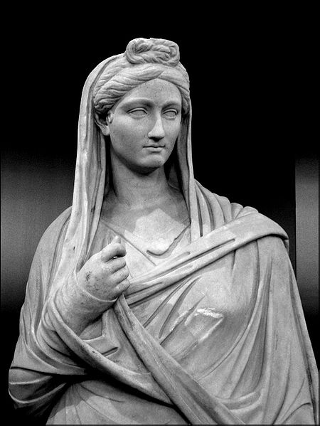
Exceptional Women (That we actually recorded things about!)
Among the upper classes, women seem to have been well-educated, some highly so, and were sometimes praised by the male historians for their learning and cultivation.
Cornelia Metella, the young wife of Pompey the Great at the time of his death, was distinguished for her musicianship and her knowledge of geometry, literature, and philosophy.
This degree of learning indicates formal preparation.
The educated and well-traveled Vibia Sabina (ca. 136 AD) was a grand-niece of the emperor Trajan and became the wife of his successor Hadrian.
Sadly, there are also a LOT of stories about bad women.
It is from the stories of what is bad, that we can
infer what was “good”.

Slide 23
QUESTIONS?
NEXT WEEK - TEST
Multiple Choice
Know Latin words (up on website).
Know everything we’ve covered on the website (videos & presentations)
Matching
Know the 7 structures from the video:
What’s its name.
Who built (if there is one person)?
What was it used for?
Essay
Know your Roman expressions and be able to explain them.

