Slide 1
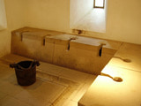
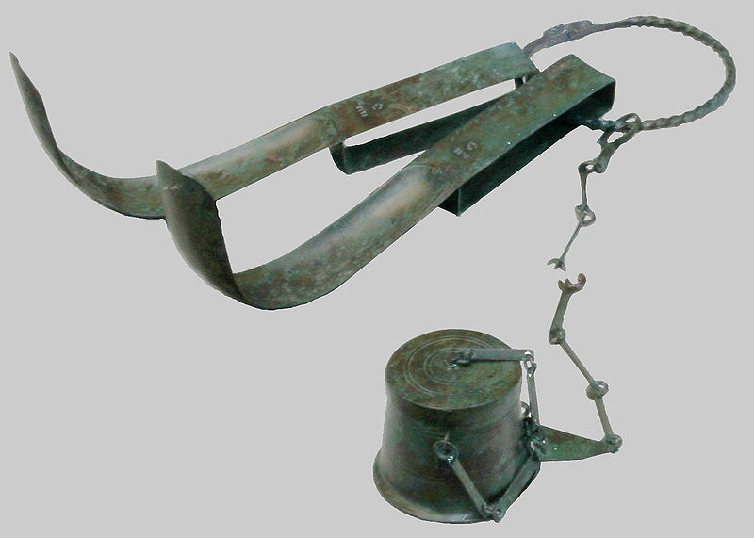
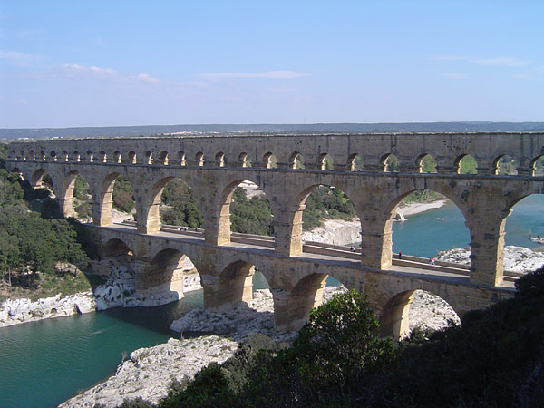
To Pee, or Not to Pee? That is the Question.
Daily Life in Ancient Rome w/ Mr. C

Slide 2
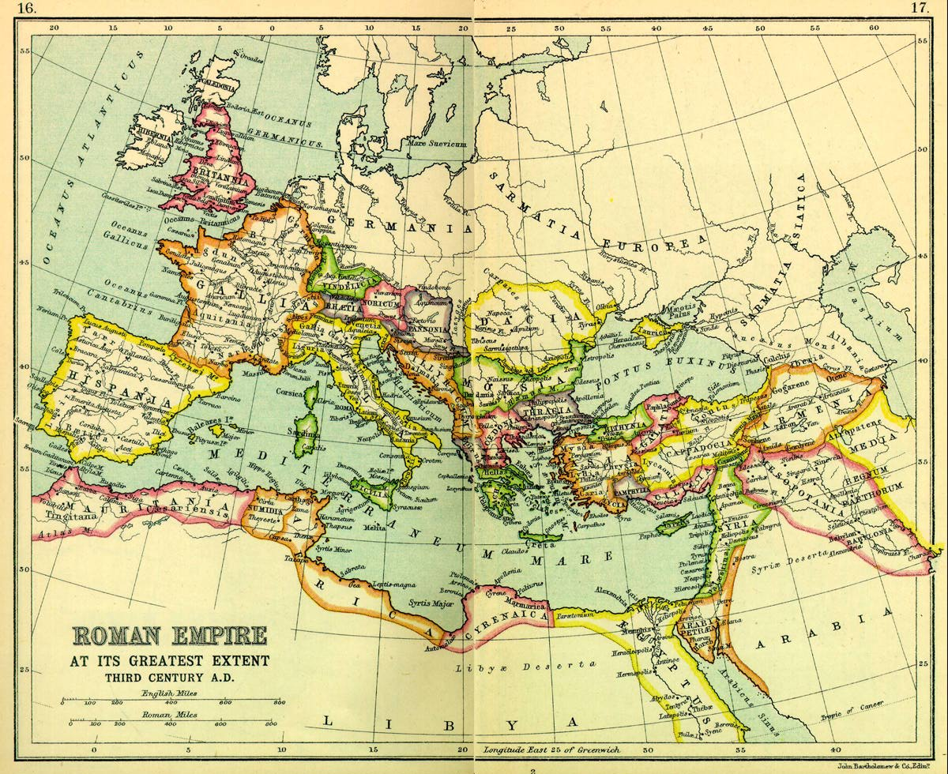

Slide 3
Roman Hygiene
Hygiene in ancient Rome included the famous public Roman baths, toilets, exfoliating cleansers, public facilities, and -- communal toilet sponge (ancient Roman Charmin®).
high standards of cleanliness!
dutifully rinsed out after use!!!
Urns for collecting urine
for the fullers…

Slide 4
How did they wash?
Call for the bathroom attendant.
Dip hands in water.
Dry them on his head.
Don’t you want hair like Mr. C now?
Mine would be useless!!!

Slide 5
A ditty by Martial:
“In omnibus Vacerra quod conclavibus consumit horas et die toto sedet, cenaturit Vacerra, non cacaturit.”
“Why does Vacerra spend his hours in all the privies, and day-long stoop? He wants a supper, not a poop.“
What does this mean?

Slide 6
A ditty by Martial:
“Why does Vacerra spend his hours in all the privies, and day-long stoop? He wants a supper, not a poop.“
Things like this tell us:
They were comfortable places
One might sit and read
Or otherwise "amuse oneself sociably"
Socialize and hope for [dinner] invitations

Slide 7
Urine Tax
Public urinals consisted of buckets, dolia curta.
The contents were regularly collected and sold to the fullers for cleaning wool, etc.
That's where the tax story comes in.
The fullers were the ones who were taxed.
The collectors had public contracts and could be fined if late.
FAVORITE STORY!!!
Emperor Vespasian (69AD to 79AD)

Slide 8
Titus Flavius Caesar Vespasianus Augustus
distrusted philosophers in general, viewing them as unmanly complainers who talked too much
Much money was spent on public works and the restoration and beautification of Rome:
a new forum, the Temple of Peace, the public baths and the great show piece, the
urinals are still named after him (for example, vespasiano in Italian, and vespasienne in French
Why?

Slide 9
Back to bathrooms and “pots”
“They were so poor they didn’t even have a pot to pee in.”
Hygiene in the Roman World was limited to the rich and famous, except for those who could afford the public baths or thermaes.
Running water did not reach the poor's tenements from the aqueducts.
These lesser folks relieved themselves in pots or commodes which were emptied into vats located under staircases and these emptied into cesspools throughout the city.

Slide 10
The element, Plumbunium
The rich and famous, from the emperor on down, enjoyed running water in palaces and mansions from lead pipes connected to the aqueducts.
At Pompeii, for instance, all houses except the poorest had water pipes fitted with taps, and the waste water was piped away into sewer or trench.

Slide 11
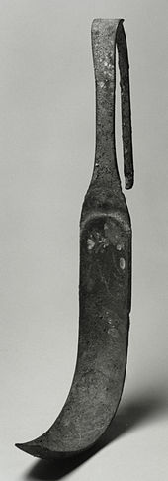
Tools of the Trade
Strigil
Asmall, curved, metal tool used in ancient Greece and Rome to scrape dirt and sweat from the body before effective soaps became available.
First perfumed oil was applied to the skin, and then it would be scraped off, along with the dirt.
For wealthier people, this process was often done by slaves.
Strigils were often used in Roman baths and were made in different sizes for different areas of the body.

Slide 12
The Bath!
The Romans recycled public bath waste water by using it as part of the flow that flushed the latrines.

Slide 13
The Problem of Thieves
At the baths there were storage nooks for clothing, utensils, oil and strigil.
Theft was a problem in Roman bath houses, so slaves watched bathers' property.
It was better to have someone looking out, but hot as the baths were, it was easy to fall asleep.
Slaves could also be tempted by profit and sometimes sold their masters' garments.

Slide 14
So what to do?
Curse tablets punished those who stole.
Minerv(a)e de(ae) Suli donavi furem qui caracallam meam involavit si ser(v)us si liber si baro si mulier hoc donum non redemat nessi sangu(i)n[e] suo.

Slide 15
So what to do?
Curse tablets punished those who stole.
Curse tablets which were pieces of lead or pewter rolled or folded and thrown into the spring or nailed to the bathing establishment. Inscribing on his piece of lead the victim would call on the god to right the wrong, by bringing the criminal to justice and retrieving the lost article.
A victim of theft might seek the god's vengeance or double the likelihood of divine help by transferring ownership of his stolen garment (or other article of value) to the god who would then want to retrieve the garment in his own interest.

Slide 16
Next Time
Food
Bathrooms
City Life
Religion
Women
War
Home Life
Y mucho, mucho mas!

