Slide 1
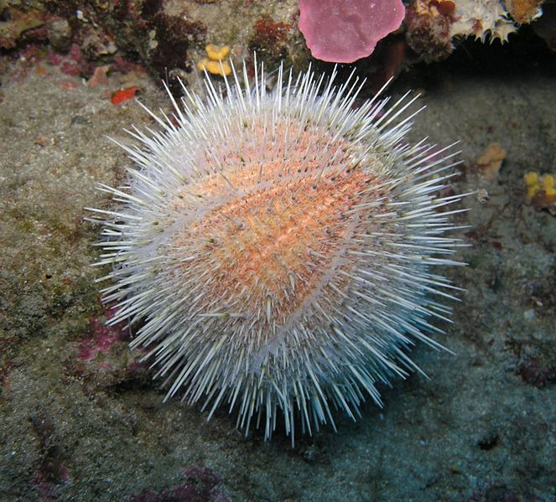
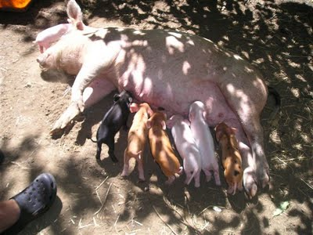
Dormice, Sea Urchins, or Sow Udders?
Daily Life in Ancient Rome w/ Mr. C

Slide 3
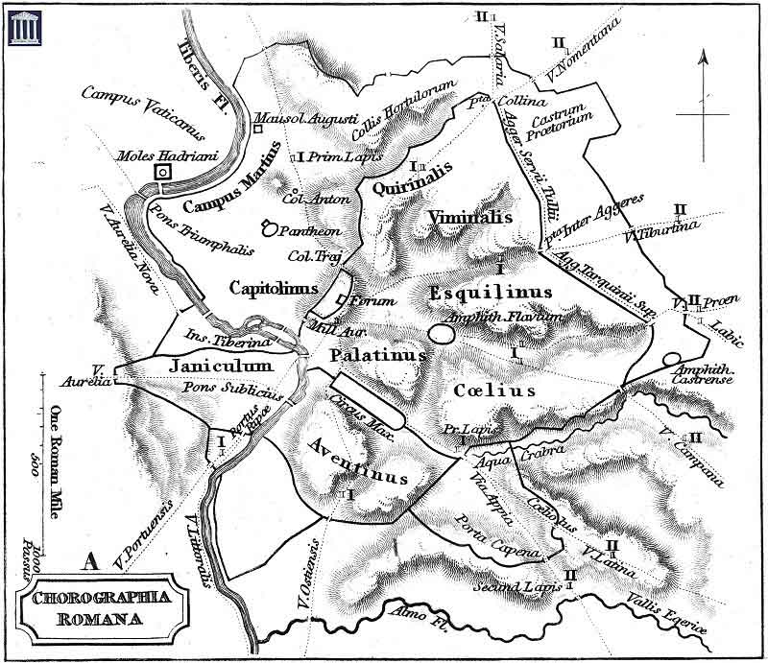
The 7 Hills of Rome

Slide 4
The NORMAL Roman Meal
The Romans did not eat huge meals.
Their main food was pottage. Pottage is a kind of thick stew made from wheat, millet or corn. Sometimes they would add cooked meat, offal or a sauce made out of wine.
Food for the common people consisted of wheat or barley, olive oil, a little fish, wine, home grown vegetables, and if they were lucky enough to own a goat or cow or chickens, cheese and a few eggs.

Slide 5
The NORMAL Roman Meal
As the Republic grew and expanded, the Romans came into contact with food from other countries. They used herbs and spices to flavor their food and began eating more fish, especially shell fish.
Vegetables were plentiful and most of the Roman's recipes included vegetables. They also ate a lot of fruit, especially grapes, and made wine.
The Romans ate their food with their fingers. They used knives made from antlers, wood or bronze with an iron blade to cut their food. They also had spoons made from bronze, silver and bone which they used to eat eggs, shellfish and liquids.

Slide 6
Food, Glorious Food!!!
During the Roman Republic, there were Sumtuariae Leges ('sumptuary laws') designed to limit extravagance, including the amount spent on a given meal, which directly impacted how much wealthy Romans could eat at their meals.
By the Imperial period such laws were no longer in force.

Slide 7
Food, Republic Style
Poor Romans continued to eat mostly cereal grain, at all meals, as porridge or bread.
Women engaged in a daily grain-to-flour grinding.
They placed the hard kernels between a concave stone and a smaller one serving as a roller.
This was called called a "thrusting mill." Later, they sometimes used a mortar and pestle.
For rich Romans…

Slide 8
For Breakfast or Lunch?
For those who could afford it, breakfast (jentaculum), eaten very early, would consist of salted bread, milk or wine, and perhaps dried fruit, eggs or cheese.
It was not always eaten. The Roman lunch (cibus meridianus or prandium), a quick meal, eaten around noon could include salted bread or be more elaborate with fruit, salad, eggs, meat or fish, vegetable, and cheese.

Slide 9
And then a sensible dinner.
The dinner (cena), the main meal of the day, would be accompanied by wine, usually well-watered.
The Latin poet Horace (lived during Augustus’ time) ate a meal of onions, porridge, and pancake.
An ordinary upper class dinner would include meat, vegetable, egg, and fruit.
Comissatio was a final wine course at dinner's end.
Don’t forget the fermented fish sauce (YUCK!).

Slide 10
Table Manners? Try Couch Manners!
It is believed that during the Roman Republic most women and the poor ate sitting on chairs, while upper class males reclined on their sides on couches along three sides of a cloth-covered table (mensa).
The 3-sided arrangement is called the triclinium. Banquets might last for hours, eating and watching or listening to entertainers, so being able to stretch out without shoes, and relax must have enhanced the experience. Since there were no forks, diners would not have had to worry about coordinating eating utensils in each hand.

Slide 11
Table Manners? Try Couch Manners!
It is believed that during the Roman Republic most women and the poor ate sitting on chairs, while upper class males reclined on their sides on couches along three sides of a cloth-covered table (mensa).
The 3-sided arrangement is called the triclinium. Banquets might last for hours, eating and watching or listening to entertainers, so being able to stretch out without shoes, and relax must have enhanced the experience. Since there were no forks, diners would not have had to worry about coordinating eating utensils in each hand.

Slide 12
Triclinium

Slide 13
Triclinium 2

Slide 14
How do we know all this?
It was VERY popular to record what was served at meals and include recipes when possible.
My favorite?
HONEYED MUSHROOMS
Ingredients: 25g dried mushrooms 2 tbsp red wine vinegar pinch of salt 1 tbsp clear honey sea salt to taste.
Method: Place the mushrooms in a bowl and cover with boiling water, allowing them to soak for an hour. Pour this mixture into a saucepan, add the honey and vinegar and bring to the boil. Cover and simmer for half an hour. Season with salt and serve. This mushroom mixture goes particularly well with game.
See Handout on Website

Slide 15
Next Time
Food
Bathrooms
City Life
Religion
Women
War
Home Life
Y mucho, mucho mas!

