Slide 1
The Formation of the Republic & The Empire Stikes Back
Daily Life in Ancient Rome w/ Mr. C

Slide 3
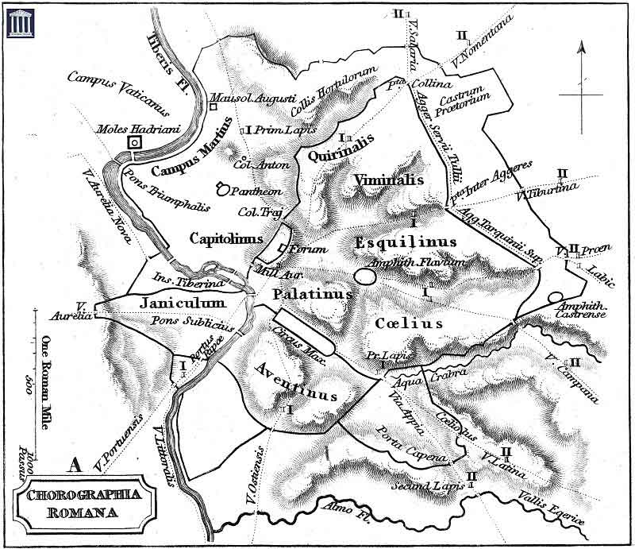
The 7 Hills of Rome

Slide 5
Etruscan Temples
An Etruscan temple, to meet religious requirements, was located on a north-south axis and stood on a high podium with a four-columned porch in front of three doors leading to three parallel rooms for the three chief Etruscan gods.
The brilliantly painted terracotta statuary that decorated the roof along the eaves, ridge pole, and at the gable ends also served the practical purpose of hiding and protecting tile joints and rafter ends. Plaques with low-relief figures adorned the entablature.

Slide 6
Etruscan Culture
Pairing: Husband & Wife
Kinship among the Etruscans was vertical, or generational. They kept track of six generations.
The names of persons are generally binomial: Vethur Hathisna, Avile Repesuna, Fasti Aneina.
Etruscan state government was essentially a theocracy.
The political unit of Etruscan society was the city-state.

Slide 7
Etruscan Gods & Goddesses
Catha and Usil, the sun
Tivr, the moon
Selvan, a civil god
Turan, the goddess of love
Laran, the god of war
Leinth, the goddess of death
Maris, Thalna, Turms and the ever-popular Fufluns
The Etruscans believed in intimate contact with divinity.
They did nothing without proper consultation with the gods and signs from them.
Augery
Auspices

Slide 8
What do the Romans…
ADOPT
The power of religion and mysticism. The Etruscans were profoundly and eternally influenced by mysticism and what we would generally refer to as "superstition".
REJECT
The position of women in Etruscan society. As opposed to Roman and Greek societies, Etruscan women sat with their husbands at banquets, had their own personal possessions and were actively involved in day to day politics. From the point of view of Roman morality Etruscan women were immoral and dissolute.

Slide 9
Phases of Rome
Roman Monarchy (753 B.C. – 510 B.C.)
Roman Republic (509 B.C. – 44 B.C.)
(Mar. 15= The Ides of March).
Murder of Caesar. 44 B.C
Roman Empire (30 B.C. – 476 A.D./1453 A.D.)
Caesar Augustus, 1st citizen
Imperatur

Slide 10
For the Royalty!
1. Romulus 753-715 B.C.
Romulus was the legendary founder of Rome. The Sabine king of Cures, Tatius, co-ruled with Romulus.
2. Numa Pompilius 715-673 B.C.
Numa Pompilius is credited with many of the ancient religious conventions of ancient Rome.
3. Tullus Hostilius 673-642 B.C.
Tullus Hostilius doubled the population of Rome, added Alban nobles to the Senate of Rome, and built the Curia Hostilia. He was a warrior.
4. Ancus Martius 642-617 B.C.
Ancus Marcius was a grandson of Numa Pompilius and a bridge builder. The bridge across the Tiber is credited to Ancus Marcius.

Slide 11
The Last of the Kings
5. L. Tarquinius Priscus 616-579 B.C.
The first of these new kings, it is said, came from the Etruscan city of Tarquinii, from which he derived his name. The story is told that, as he approached the city, an eagle came from the sky, and, lifting his cap from his head, replaced it. His wife, who was skilled in the Etruscan art of augury, regarded the eagle as a messenger from heaven, and its act as a sign that her husband was to acquire honor and power. Tarquinius Priscus had a Corinthian father. Tarquin created 100 new senators and expanded Rome. He also established the Roman games.
6. Servius Tullius 578-535 B.C.
The next king was Servius Tullius, who is said to have been the son of a slave in the royal household, and whom the gods favored by mysterious signs. Servius Tullius was the son-in-law of Tarquinius Priscus. He divided the Roman citizens into tribes and fixed the military obligations of 5 census-determined classes.
7. Tarquinius Superbus (Tarquin the Proud) 534-510 B.C.
Tradition represents the last king, Tarquinius Superbus, as a cruel despot. He obtained the throne by murder, and ruled without the consent of the senate or the people. He loved power and pomp. He was forcibly ousted by Brutus.

Slide 12
Formation of the Republic
Having witnessed the problems of monarchy on their own land, and aristocracy and democracy among the Greeks, the Romans opted for a mixed form of government, with 3 branches of government.
Consul
Senate
Assembly

Slide 13
Consuls
Consuls - The Monarchical Branch of Roman Government in the Roman Republic:
Two magistrates called consuls carried on the functions of the former kings, holding supreme civil and military authority in Republican Rome. However, unlike the kings, the office of consul lasted for only one year. At the end of their year in office, the ex-consuls became senators for life, unless ousted by the censors.
The 1-year term, veto, and co-consulship were safeguards to prevent one of the consuls from wielding too much power.

Slide 14
Senate
Senate - The Aristocratic Branch of Roman Government in the Roman Republic:
Senate (senatus = council of elders [related to the word "senior"]) was the advisory branch of the Roman government, early on composed of about 300 citizens who served for life. They were chosen by the kings, at first, then by the consuls, and by the end of the 4th century, by the censors. The ranks of the Senate, drawn from ex-consuls and other officers. Property requirements changed with the era. At first senators were only patricians but in time plebeians joined their ranks.

Slide 15
Assembly
Assembly - The Democratic Branch of Roman Government in the Roman Republic:
The Assembly of Centuries (comitia centuriata), which was composed of all members of the army, elected consuls annually. The Assembly of Tribes (comitia tributa), composed of all citizens, approved or rejected laws and decided issues of war and peace.

Slide 16
Censor - 443-22 B.C.
In ancient Rome, censors were census-takers and morality keepers.
The comitia curiata elected the censores.
At first their term of office was a lustrum or about 5 years, but it was soon reduced to a period of 18 months.
Although the censors were awarded no imperium (roughly, power), and therefore had no lictors to serve as axe-carrying bodyguards, the office was above the consul and second only to the office of dictator in dignity.
(339 B.C.) One of the censors must be a plebeian.

Slide 17
Cato the Elder (234-149 B.C.)
Carthago delenda est

Slide 18
Growth of Rome - Steps to Unification
Etruscans and Gauls squeezed out by Latins
290- conquered central Italy then Samnites in South
265 took over Greek city states
Why?
Staying power of army
Won over conquered people
Became Roman citizens

Slide 19
Meanwhile, back in Rome, the importance of citizenship
gradual struggle between the patrician and plebeian classes
2 consuls and Senate made up of patricians
popular assemblies established with a representative tribune- veto power
450 B.C. 12 Tables Roman Law codified
Result- increase of privileges for plebes

Slide 20
The Punic Wars 264-146 BCE
Major rival in Med- Phoenician Carthage
First Punic War 264-42- copied ships and corvus
out of Sicily
Second Punic war 218-202- Hannibal 216 Battle of Camnae
Third- treaty infringement trumped up Cato’s speech
Carthago delenda est” Carthage plowed and sowed with salt
Result Rome now the POWER in the Mediterranean

Slide 21
Struggles Continue in the Republic
Graft*, corruption, struggle between patrician and plebeians
Gracchi Brothers Tiberias and Gaius
Marius consul 6 x
Sulla- general seized Rome in 82 BCE restored power to Senate
set precedent
* unscrupulous use of a politician's authority for personal gain.

Slide 22
Republic’s Last Gasp
First Triumvirate Julius Caesar, Pompey, Crassus
Julius Caesar challenges the Senate crosses the Rubicon
47 BCE virtual ruler, increased Senate to 900
44 BCE assassinated, Second Triumvirate
Octavius, Marc Antony, Lepidus
Battle of Actium 31 BCE End of an era

Slide 23
The Roman Empire
Caesar Augustus- purpose “to restore the republic”
27 B.C. Augustus become “First Citizen” Princeps
ended strife- beginning of Pax Romanae
tried to impact life- morality, building
sculpture- deified him, literature as well
Consolidation- of power/ Senate limited
SPQR Senatus Populusque Romanus- banner

Slide 24
The Roman World
Ever expanding- see maps- spread Pax Romanae
Politically - emperor/ dictatorship
Extended Roman citizenship as they spread
The Roman family- gradual less influence for fathers
family strong unit- run like the state
women become more independent- socially and ownership
politically active as wives of emperors- Livia, wife of CA

Slide 25
Next Time
Food
Bathrooms
City Life
Religion
Women
War
Home Life
Y mucho, mucho mas!

