Slide 1
The Glory That was Greece & The Grandeur That was Rome
Daily Life in Ancient Rome w/ Mr. C

Slide 2
Overview of Roman History
Ancient Rome was at first a small agricultural community founded circa the 8th century BC (700’s) that grew over the course of the centuries into a colossal empire encompassing the whole Mediterranean Sea, in which Ancient Greek and Roman cultures merged into one civilization. This civilization was so influential that parts of it survive in modern law, administration, philosophy and arts, forming the ground that Western civilization is based upon.
In its twelve-century existence it transformed itself from monarchy to republic and finally to autocracy. In steady decline since the 2nd century AD, the empire finally broke into two parts in 285 AD: the Western Roman Empire and the Byzantine Empire in the East. The western part under the pressure of Goths finally dissolved, leaving the Italian peninsula divided into small independent kingdoms and feuding city states for the next 14 centuries, and leaving the eastern part sole heir to the Roman legacy.

Slide 3
The End
We will have our final in 5 minutes.
Questions?

Slide 5
Why study Rome?
“The Romans knew how to govern people, establish legal structures and construct roads that took them to the ends of their known world”

Slide 7
Geography- Locus-Locus-Locus
Middle of the Mediterranean
Larger and more arable land than Greece- mts north and south
River valleys- Po in the North, Tiber in middle of boot
Rome - inland accessible by boat- defensible,on “Seven Hills”
Capitoline
Quirinal
Viminal
Esquilin
Cælian (Coelian/Celio)
Aventine
Palatine

Slide 8
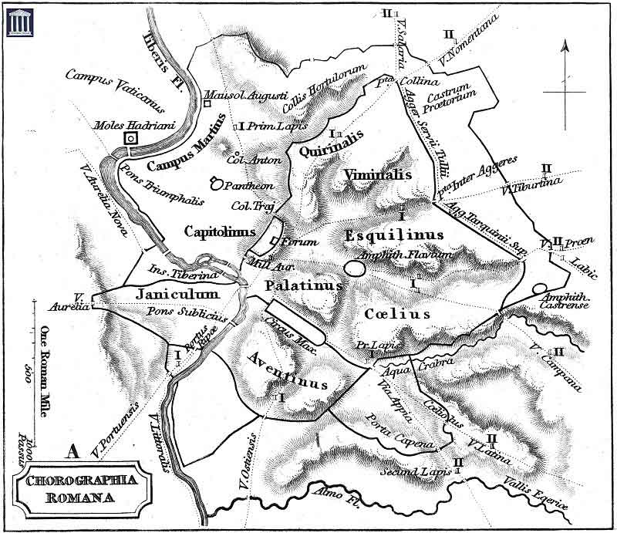
The 7 Hills of Rome

Slide 11
Origins of Rome
Legend: Romulus and Remus raised by she-wolf 733BC traced boundaries with plow
Later: Virgil’s Aeneus, hero of Troy, roams the Med looking for a home
Reality: Etruscans
unsure of origin
used iron, bronze and silver
Rome and Latins under rule of king
beginning fear of kings, rebelled
invaded by Gaul 390 BC

Slide 12
Boring!
Let’s look at the real origins of Rome.
Romulus and Remus were twin brothers.
The grandfather and great-uncle of the twins were Numitor and Amulius.
Amulius seized Numitor's share and became sole ruler.
Rhea Silvia (also called Ilia) made a vestial virgin.
Since vestal virgins could be buried alive if they violated their chastity vows, whoever forced Rhea Silvia to enter the equivalent of an ancient convent assumed that Rhea Silvia would remain childless.
Amulius had a swineherd, Faustulus, leave the twins on the river bank to die.
BUT a she-wolf nursed them, and a woodpecker fed and guarded them

Slide 13
Or maybe…
The Trojan prince Aeneas, an important figure linking the Romans with the Trojans and the goddess Venus, escaped from Troy with his son in his arms and carrying his father on his back. He led his men to Africa, Sicily and finally Etruia. Setting up a kingdom in Alba Longa.

Slide 14
Kidding. This is Barocci’s version.

Slide 15
Who were the Etruscans?

Slide 16
Who were the Etruscans?
The Etruscans, who lived in Etruria, were known as Tyrrhenians by the Greeks. They were at their height in Italy from the 8th to the 5th century B.C.
They inhabited the triangular area between the Mediterranean Sea and the rivers Arno and Tiber in central Italy.
Herodotus says the Etruscans came from Lydia, in Asia Minor, as the result of a famine around 1200 B.C., like the Irish coming to the U.S. as a result of a potato famine in the 19th century.
(This one has DNA evidence!)

Slide 17
Who were the Etruscans?
Etruscans built such cities as Tarquinii, Vulci, Caere, and Veii.
Etruscan homes were mud-brick, with timber on stone foundations, some with upper stories.
But their temples…

Slide 18
Etruscan Temples

Slide 19
Etruscan Temples
An Etruscan temple, to meet religious requirements, was located on a north-south axis and stood on a high podium with a four-columned porch in front of three doors leading to three parallel rooms for the three chief Etruscan gods.
The brilliantly painted terracotta statuary that decorated the roof along the eaves, ridge pole, and at the gable ends also served the practical purpose of hiding and protecting tile joints and rafter ends. Plaques with low-relief figures adorned the entablature.

Slide 20
Etruscan Culture
Pairing: Husband & Wife
Kinship among the Etruscans was vertical, or generational. They kept track of six generations.
The names of persons are generally binomial: Vethur Hathisna, Avile Repesuna, Fasti Aneina.
Etruscan state government was essentially a theocracy.
The political unit of Etruscan society was the city-state.

Slide 21
Etruscan Gods & Goddesses
Catha and Usil, the sun
Tivr, the moon
Selvan, a civil god
Turan, the goddess of love
Laran, the god of war
Leinth, the goddess of death
Maris, Thalna, Turms and the ever-popular Fufluns
The Etruscans believed in intimate contact with divinity.
They did nothing without proper consultation with the gods and signs from them.
Augery
Auspices

Slide 22
What do the Romans…
ADOPT
The power of religion and mysticism. The Etruscans were profoundly and eternally influenced by mysticism and what we would generally refer to as "superstition".
REJECT
The position of women in Etruscan society. As opposed to Roman and Greek societies, Etruscan women sat with their husbands at banquets, had their own personal possessions and were actively involved in day to day politics. From the point of view of Roman morality Etruscan women were immoral and dissolute.

Slide 23
The Last of the Kings
Tarquinius Priscus.—The first of these new kings, it is said, came from the Etruscan city of Tarquinii, from which he derived his name. The story is told that, as he approached the city, an eagle came from the sky, and, lifting his cap from his head, replaced it. His wife, who was skilled in the Etruscan art of augury, regarded the eagle as a messenger from heaven, and its act as a sign that her husband was to acquire honor and power
Servius Tullius.—The next king was Servius Tullius, who is said to have been the son of a slave in the royal household, and whom the gods favored by mysterious signs.
Tarquinius Superbus.—Tradition represents the last king, Tarquinius Superbus, as a cruel despot. He obtained the throne by murder, and ruled without the consent of the senate or the people. He loved power and pomp.

Slide 24
Formation of the Republic
Next time

